Slide 1
Digital Portfolio
STUDENT NAME: S. VASANTH
REGISTER NO AND NMID: 24131061802521088 AND
03BCBA9D35224779E8F4F4855BE7DAA4
DEPARTMENT: B.Sc COMPUTER SCIENCE (II YEAR)
COLLEGE: COLLEGE/ UNIVERSITY: SHREE RAGHAVENDRA
ARTS AND SCIENCE COLLEGE KEEZHAMOONGILADI
AFFILIATED ANNAMALAI UNIVERSITY
CHIDAMBARAM.

Slide 2
PROJECT TITLE
PORTFOLIO WEB PAGE

Slide 3


AGENDA
Problem Statement
Project Overview
End Users
Tools and Technologies
Portfolio design and Layout
Features and Functionality
Results and Screenshots
Conclusion
Github Link
3/21/2024 Annual Review

Slide 4

PROBLEM STATEMENT
A personal portfolio website that is responsive, clean, and user-friendly. It highlights personal information, projects, and achievements while allowing easy contact through a form or social links.

Slide 5

PROJECT OVERVIEW
This project is a personal portfolio website built with HTML, CSS, and JavaScript to showcase profile details, projects, and contact information in a clean and responsive design.

Slide 6

WHO ARE THE END USERS?
recruiters, clients, and peers

Slide 7

TOOLS AND TECHNIQUES
* HTML 5* CSS 3* JAVASCRIPT* VS Code* browser developer

Slide 8
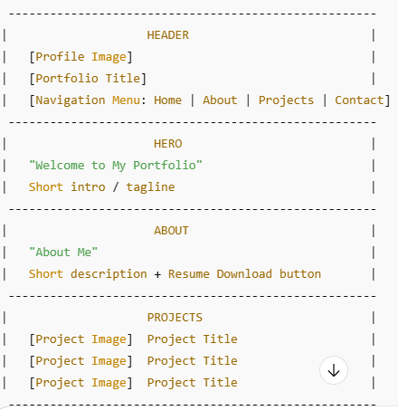
POTFOLIO DESIGN AND LAYOUT
8

Slide 9
FEATURES AND FUNCTIONALITY
Profile Section: Displays a profile image and introduction.
Navigation Menu: Easy access to Home, About, Projects, and Contact sections.
Hero Section: A welcoming highlight with a brief introduction.
About Section: Provides background information and resume download option.
Projects Section: Showcases project images with titles for quick viewing.
Contact Form: Allows users to send messages with instant acknowledgment.
Responsive Design: Ensures the website adapts to desktops, tablets, and mobile devices.
Interactive UI: Hover effects and form handling improve user experience.

Slide 10
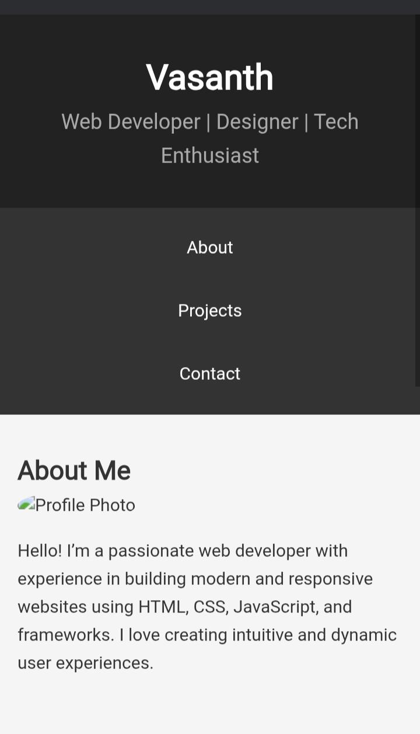
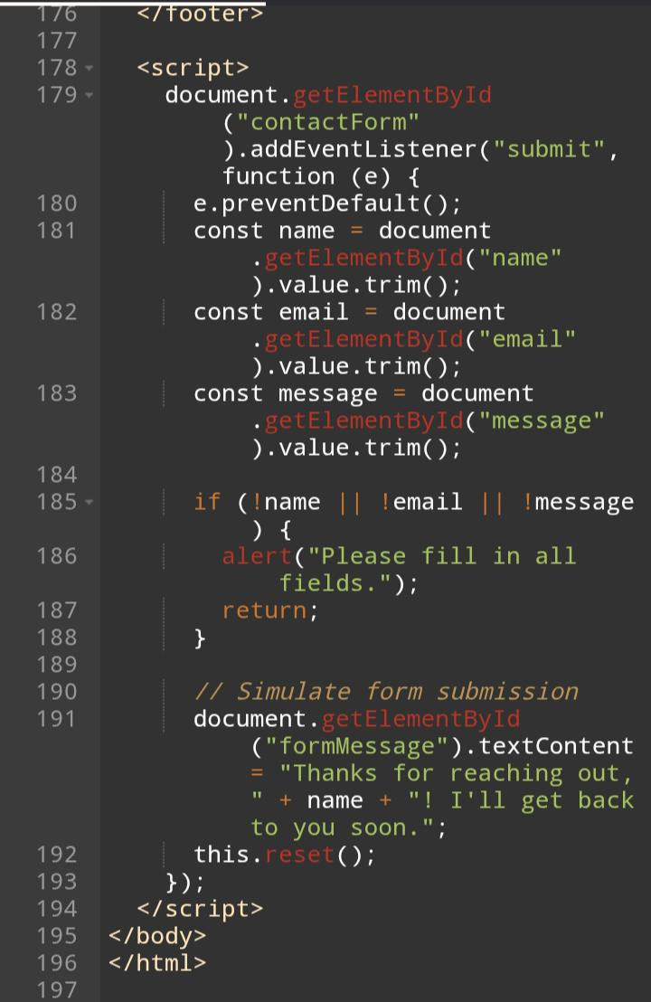
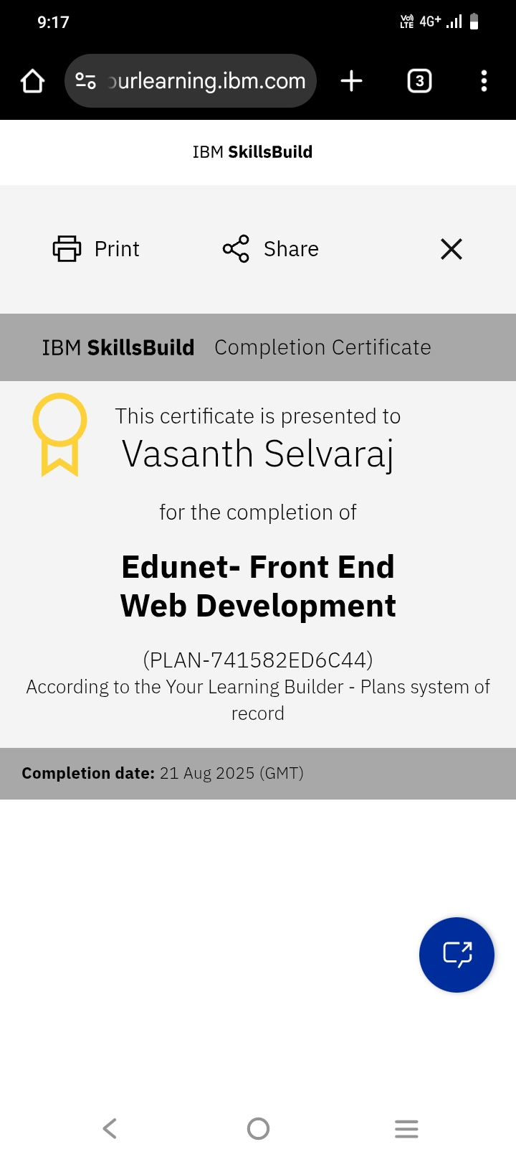
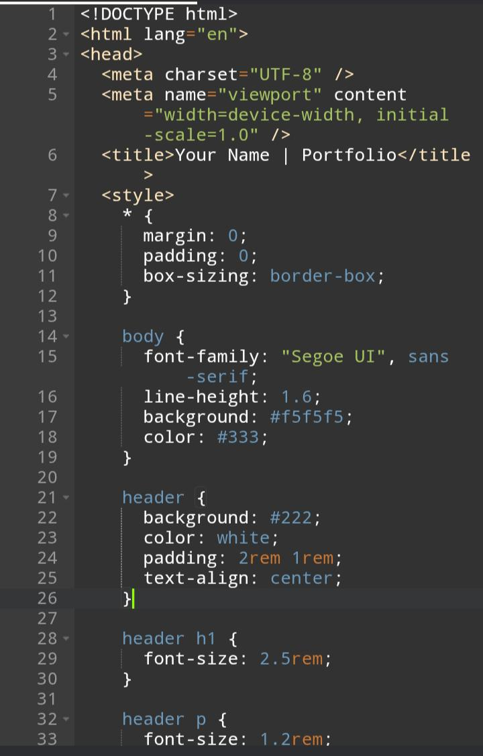

RESULTS AND SCREENSHOTS
3/21/2024 Annual Review
10

Slide 11
CONCLUSION
This portfolio website successfully showcases personal skills, projects, and contact details in a simple and interactive way. It provides a professional online presence, helping to connect with potential employers, clients, and collaborators. The responsive design ensures accessibility across devices, making it an effective tool for personal branding
11

